Slide 1
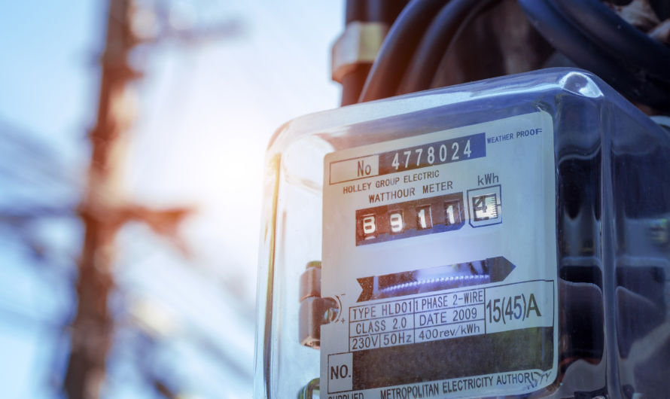
OOPS MINI PROJECT
ELECTRICITY BILL CALCULATOR

Slide 2
INTRODUCTION
In Java, there are various ways through which we can calculate electricity bills. We import javax.swing calculate electricity bills.

Slide 3
We calculate the Electricity bill as follows:
If unit <=100 the corresponding bill is printed as zero.
If unit >=101 the corresponding bill is printed as the double of the unit entered after subtracting the first 100 units.
If unit >=201 the corresponding bill is printed as the thrice of the unit entered after subtracting the first 100 units.

Slide 4
CODE TO CALCULATE THE ELECTRICITY BILL:
import javax.swing.*;
import java.awt.*;
import java.awt.event.*;
public class EBCal
{
public static void main(String args[])
{
Abc obj=new Abc();
}
}
class Abc extends JFrame implements ActionListener
{

Slide 5
JLabel l1;
JTextField t1;
JLabel l2;
JTextField t2;
JButton b;
// JLabel l3;
public Abc()
{
setLayout(new FlowLayout());
l1=new JLabel("Enter the no of units :");
t1=new JTextField(20);
l2=new JLabel("Amount");
t2=new JTextField(20);
b=new JButton("Enter");
//l3=new JLabel("Result");

Slide 6
add(l1);
add(t1);
add(l2);
add(t2);
add(b);
//add(l3);
b.addActionListener(this);
setVisible(true);
setSize(250,400);
setDefaultCloseOperation(JFrame.EXIT_ON_CLOSE);
}

Slide 7
public void actionPerformed(ActionEvent ae)
{
int units=Integer.parseInt(t1.getText());
int value=0;
// int num2=Integer.parseInt(t2.getText());
if(units < 100)
{
value = units * 0;
}
else if(units < 300){
value = 100 * 0 + (units-100) * 2;
}

Slide 8
else if(units >= 300)
{
value = 100 * 0 + (units-100) * 3;
}
//int value=num1 * 2;
t2.setText(""+ value);
//l3.setText(""+value);
}
}

Slide 9
TEAM MEMBERS
KUPPU SHANMUGANATHAN K
KISHORE L
MANIKANDAN B
RATHIESH R

